Slide 1
Gamers Aren’t Defined by Their Game

Slide 2
Gamers Aren’t Defined by Their Game
Lead-in
01
Text Analysis
02
Language Focus
03
Assignment
04

Slide 3
Learning objectives
You will be able to …
understand the main idea and structure
understand some words and phrases: define, blemish, integral…
have a better understanding of esports

Slide 4
Teaching procedures
Lead-in
Text understanding
Assignment

Slide 5

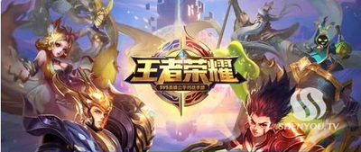

Lead-in
Have you ever played any esports?
esports= electronic sports(电子竞技)
Game for Peace
King of Glory
League Legends

Slide 6





esports competitions hosted by universities

Slide 7
Text A: Gamers Aren’t Defined by Their Game
Skimming for structure
Introduction
Para _____
1-3
Body
Para _____
4-6
Conclusion
Para _____
7

Slide 8
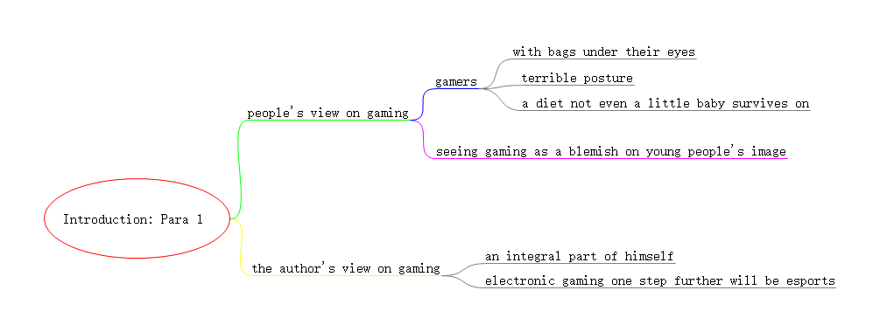
mindmapping the text

Slide 9
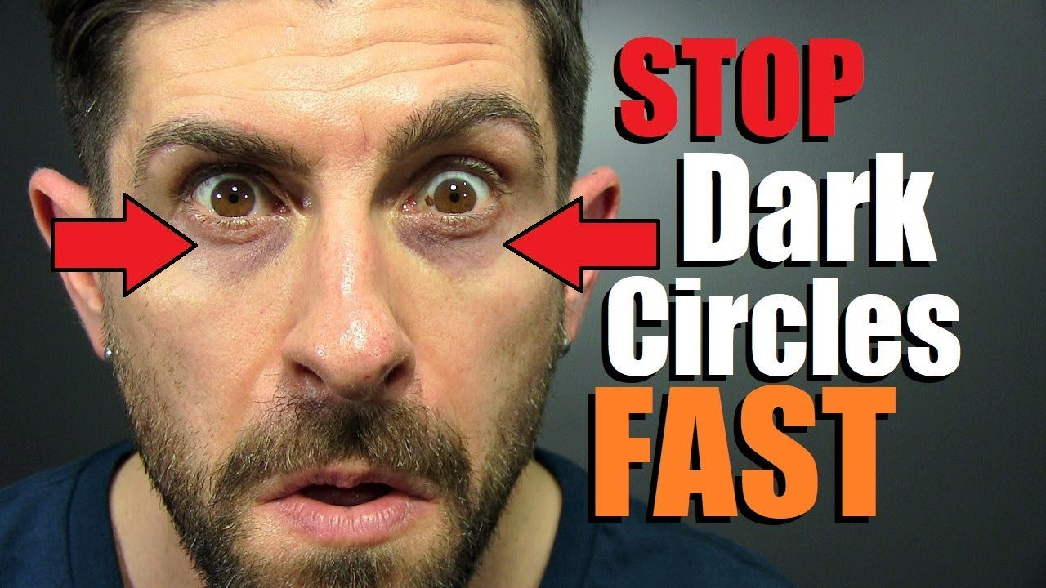
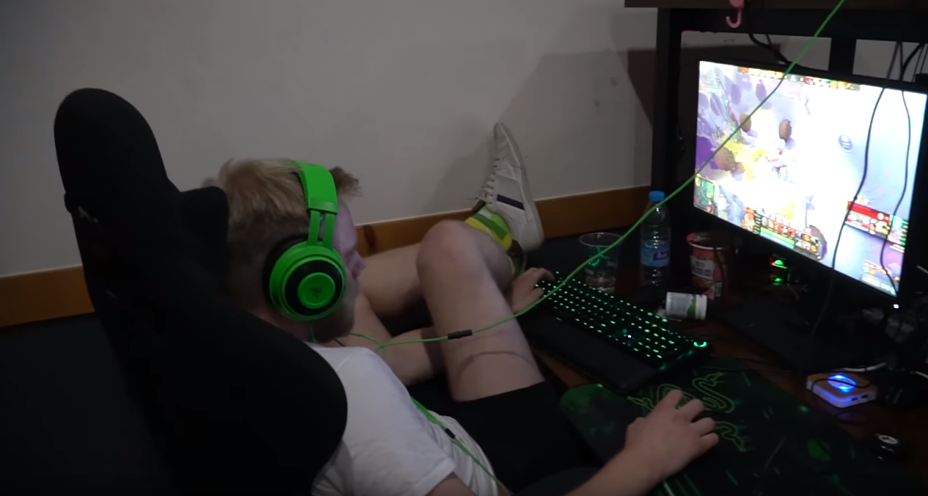
people with bags under their eyes
terrible posture

Slide 10
mindmapping the text

Slide 11
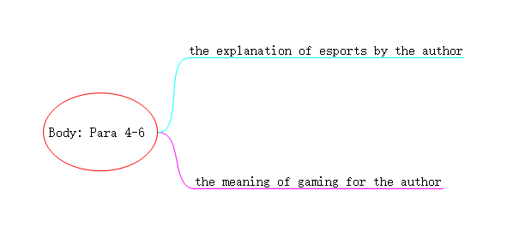
mindmapping the text
(para4)
(para5-6)

Slide 12
competition
It is a that is facilitated through Xbox or a computer.
definition
explanation of esports by the author
(para4)

Slide 13
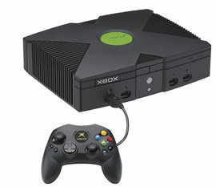
Xbox，是由美国微软公司开发并于2001年发售的一款家用电视游戏机。

Slide 14
competition
It is a that is facilitated through Xbox or a computer.
definition
physical
mental
It requires and effort.
explanation of esports by the author
Why it is considered as esports?
(para4)
strategic
hand-eye
intelligence
coordination
team work
decision making ability under pressure

Slide 15
The author’s brother introduces him to competitive gaming and esports .
sth. the author grew up with
(para5)
high speed
controlling hands with .
Why did he feel surprised?
The meaning of gaming for the author
keeping a high level of .
(para5)
critical thinking
how to play a specific game
(para5,6)
means much more than just playing
evaluate
how to certain situations
(para6)
keep cool
how to under pressure

Slide 16
reduce
correct games may help or even Alzheimer’s disease.
eliminate
Conclusion Para 7
Why?
Gaming deserves your respect

Slide 17
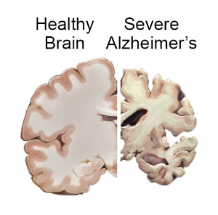
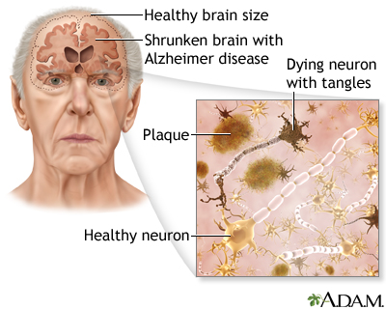
Alzheimer's disease
阿尔茨海默病（AD）是一种起病隐匿的进行性发展的神经系统
退行性疾病，临床上以记忆障碍、失语、失用、失认、视空
间技能损害、执行功能障碍及人格和行为改变等全面性痴呆
表现为特征，病因迄今未明。65 岁以前发病者，称早老性痴呆；65 岁以后发病者，称老年性痴呆。

Slide 18
reduce
correct games may help or even Alzheimer’s disease.
eliminate
Conclusion Para 7
Why?
perspectives
Gaming deserves your respect
gamers seeing from unique .
thinking
gamers in different ways.

Slide 19
Main idea: wrap-up
The whole text structurally goes like this: the author first tells the readers that are misunderstood in the media and gaming is not . Then the author gives an example of to explain the of gaming. In the end, the author calls on readers to understand gamers and .
gamers
acceptable
himself
meanings
gaming

Slide 20
  Language focus
1) not as…as (Line 2, Para.2)
but luckily it is not as acceptable as my other hobbies …
不像…一样
2) see…as(Line 1, Para.3)
Many people see gaming as a blemish on young people’s image…..
把…视为
Use not as… as and see… as to do the translation exercises.
1）许多人认为独立是通向民主的捷径( p.s. the fast track )。
2) 这本书不如那本书有趣。
Many people saw independence as the fast track to democracy.
The book is not as interesting as that one.

Slide 21
  Language focus
matching exercises
对…感到惊讶
hear of
听说
branch out
扩大范围
consist of
be surprised at
使某人初次了解某物
introduce sb. to sth.
包括，由…组成

Slide 22
hear of
branch out
consist of
be surprised at
introduce sb. to sth.
我从来没听说过这种游戏
heard of
 I have never this game.
他使我初次了解了文学
introduced me to
 He was the person who literature.
他对他所发现的那些感到很惊讶
was surprised at
He what he found.
这家书店已决定扩展业务，销售各种教科书和小说。
branch out
The bookstore has decided to into selling various textbooks and novels
该队由四个欧洲人和两个美国人组成。
consists of
■ The team four Europeans and two Americans.

Slide 23

What we have learned today …
understood the main idea and structure
mastered some words and phrases
have a better understanding of esports

Slide 24
assignment
1. Review the vocabularies and difficult sentences.
2. Learn more things about esports.

Slide 25
Thank you,
have a good day! ☺

